Slide 1
Exploring areas of London
With machine learning and Python

Slide 2
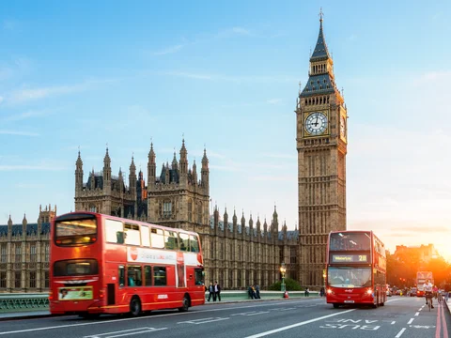
Why London?
One of the largest european cities
9 mil population
Very diverse
And why not?

Slide 3
Data sources
Wikipedia for areas of London
Geocoder + Arcgis for coordinates
Foursquare for venues

Slide 4
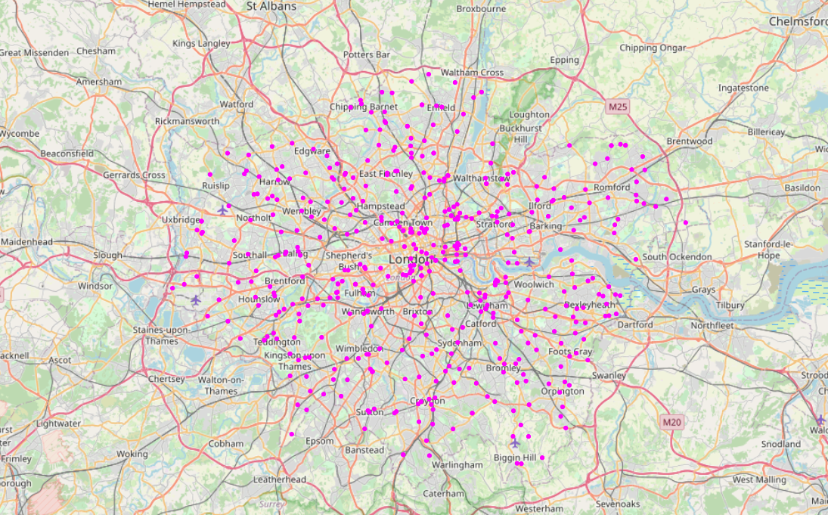
The areas
Pandas read_html makes life easy
Some data cleaning was necessary for geocoding addresses
533 locations

Slide 5
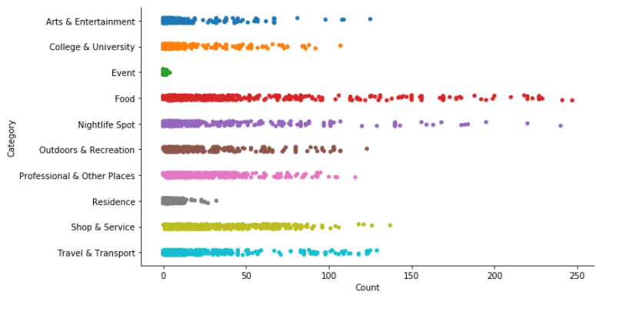
The venues
Foursquare Places API
Queried every location for main categories to get total counts

Slide 6
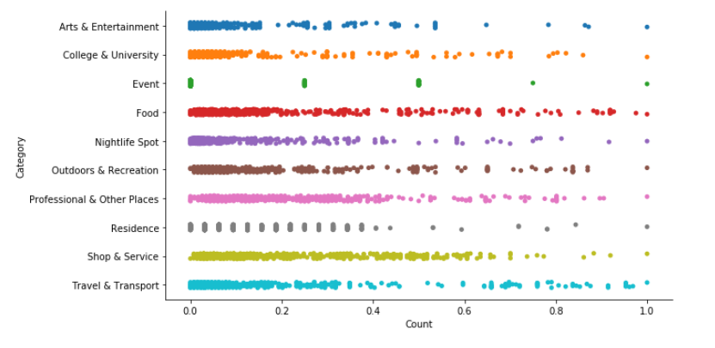
Data normalization

Slide 7
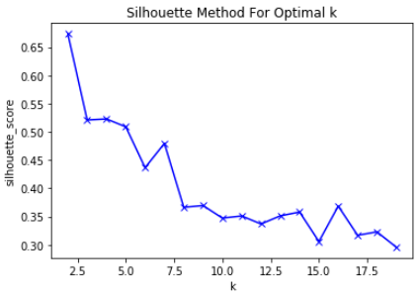
K-Means
Silhouette method
k = 4

Slide 8
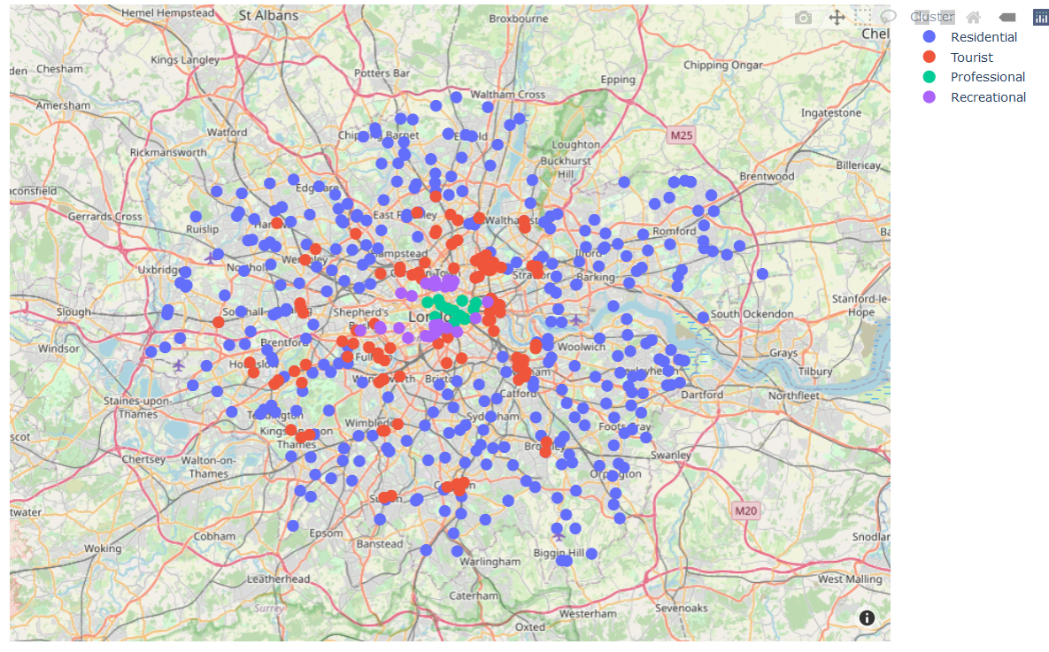
Clusters found
Touristic
Recreational
Professional
Residential

Slide 9
What’s next?
Try a more tailored selection of Foursquare sub-categories
Use venue “visits per day” as a factor
Experiment with other possibilities for K

Slide 10

Thanks!

